Slide 1
Secure Data Hiding in Image Using Steganography
CAPSTONE PROJECT
Presented By:
Student Name : Shefali Chaudhary
College Name & Department : Utkal University & Integrated MCA

Slide 2
OUTLINE
Problem Statement
Technology used
Wow factor
End users
Result
Conclusion
Git-hub Link
Future scope

Slide 3
Problem Statement
The Objective of this Project is to Develop a Secure and Robust method for Embedding Sensitive Information within Images.
It ensures that the hidden message remains undetectable to the human eye while maintaining integrity.
The embedded message is retrievable without corrupting the original image or compromising with its quality.
This method is designed so that potential attackers can’t try to extract the hidden sensitive information without authorization.

Slide 4
Technology used
Various Hardware and Software Technologies are used in this Project, which are listed as follows:
Visual Studio Code or VS Code (IDE)
CV2, OS, STRING (Libraries)
Python (Programming Language)
Microsoft Power Point for Presentation
Personal Laptop with Windows 11 and a good Processor

Slide 5
Wow factors
This Project showcases Steganography i.e., the practice of hiding information in images. In today’s evolving world, this project standout to be unique as it has many real world applications which when used in the right direction can be proved advantageous. The hiding of data in images can have wide applications in business, education, military, etc. For example, embedding a digital watermark in a file to identify its source and detect unauthorised copies of it. Hence, it can be a useful security measure too. Similarly, it has many other applications which makes this project different.

Slide 6
End users
Intelligence Agencies
Law Enforcement
Military Personnel
Ethical Hackers
Intellectual Property Owner
Journalists

Slide 7
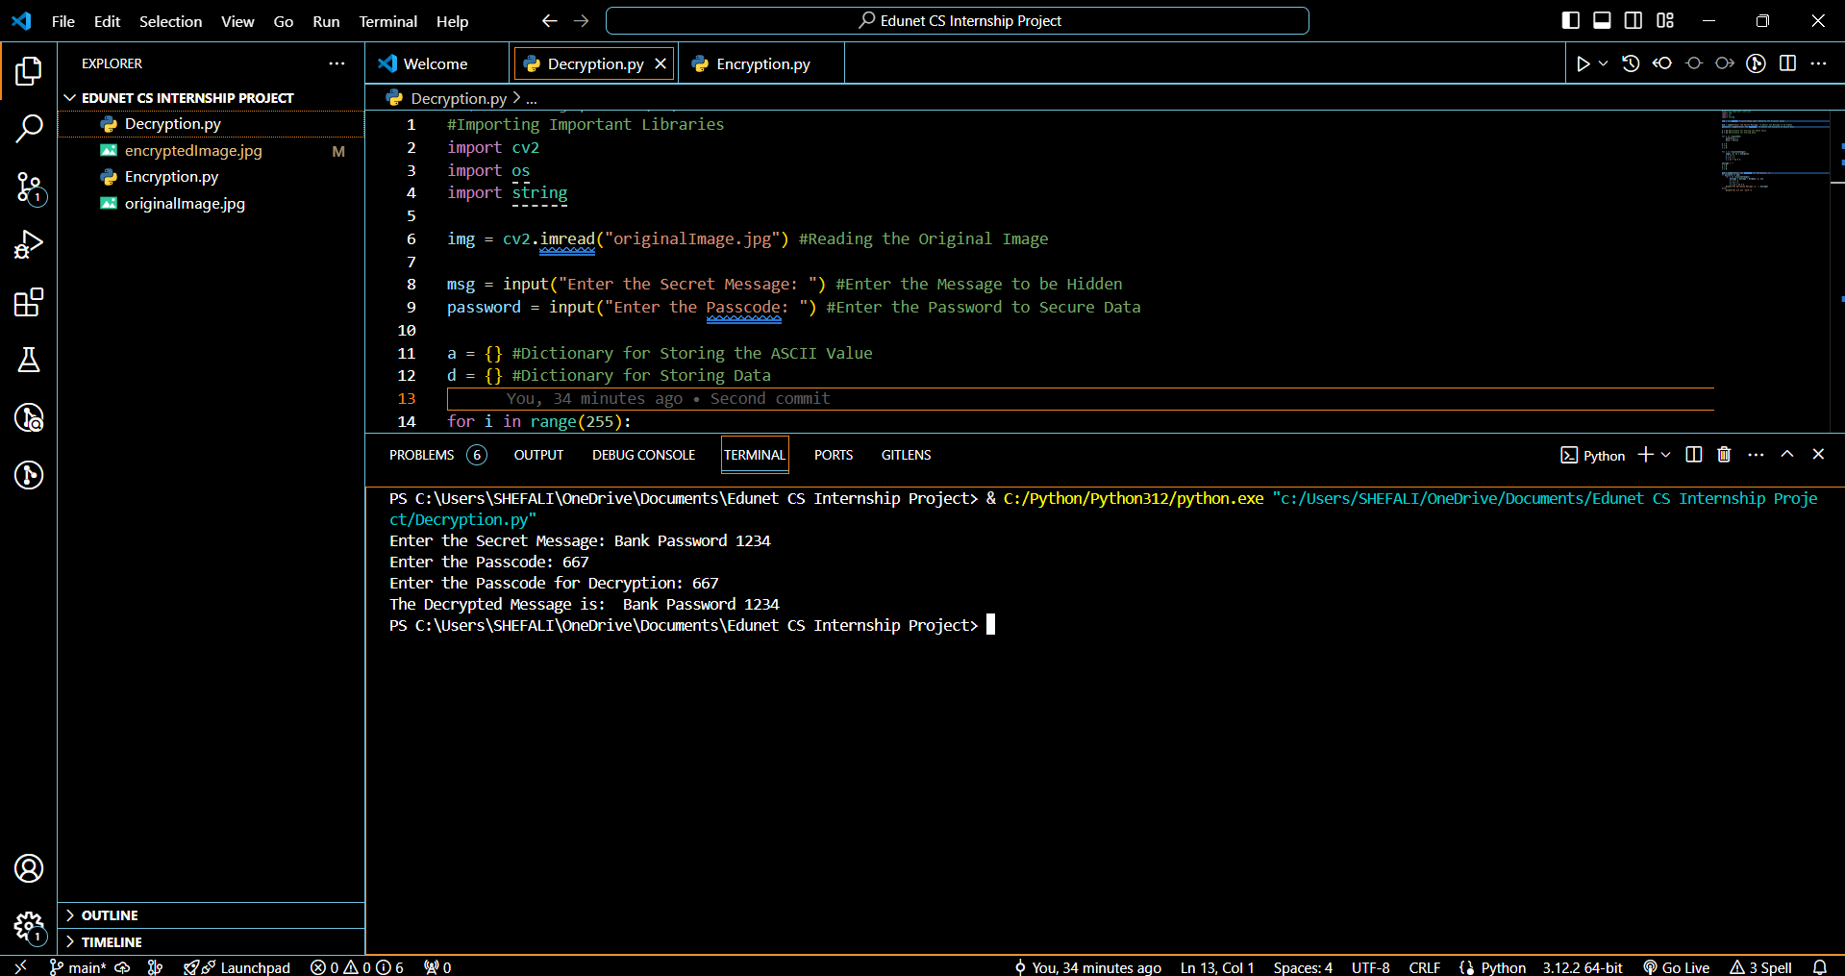
Results

Slide 8
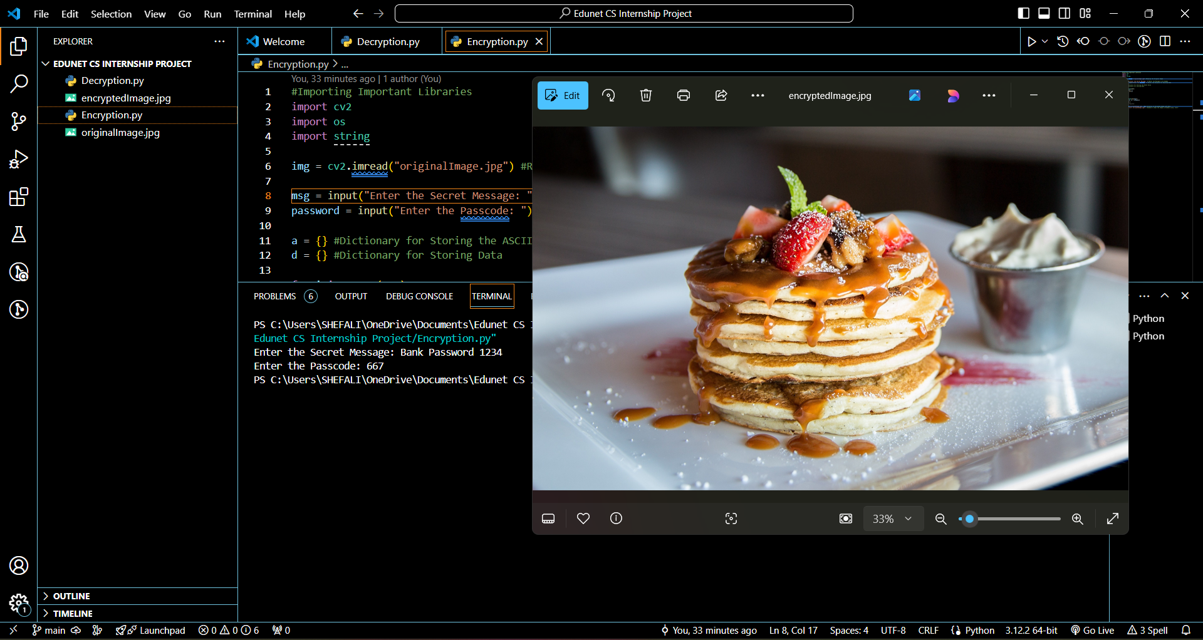

Slide 9
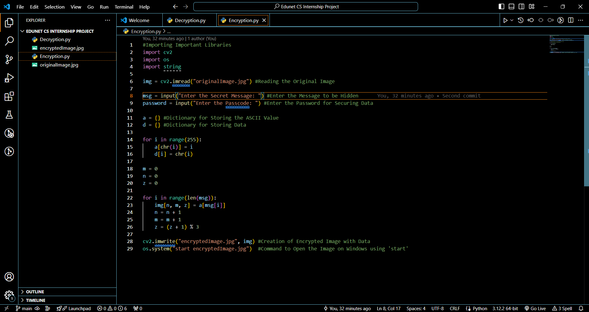

Slide 10
Conclusion
In Conclusion, Image Steganography successfully demonstrate the feasibility of discreetly embedding secret messages within digital images, providing a covert communication channel by leveraging the least significant bits of pixel values, thus maintaining the visual integrity of the carrier image while concealing sensitive information effectively. This technique holds a significant potential for secure data transmission in various applications, particularly where privacy and confidentiality are important.

Slide 11
GitHub Link
https://github.com/shefali006/CSProject.git

Slide 12
Future scope
The Future Scope of an Image Steganography project lies in developing more Robust and Secure methods for hiding Sensitive Data within Images, particularly by utilizing advanced techniques like Deep Learning, Quantum Computing, and integration with Blockchain technology, enabling applications in areas like secure communication, digital forensics, copyright protection, and medical imaging with enhanced privacy and authenticity checks.

Slide 13
THANK YOU

